Slide 1


VIRTUAL REALITY
INDUSTRIAL PREFERANCE
SUBMITTED BY:
B.PREETHI
K.V.ARUNA DEVI
S.NIRANJANA DEVI
S.KANIMOZHI

Slide 2
AGENDA :
VIRTUAL REALITY
VR IN AUTOMOBILE INDUSTRIAL
VR IN CONSTUCTION
VR IN MEDICINE
CONCLUSION
REFERENCE

Slide 3


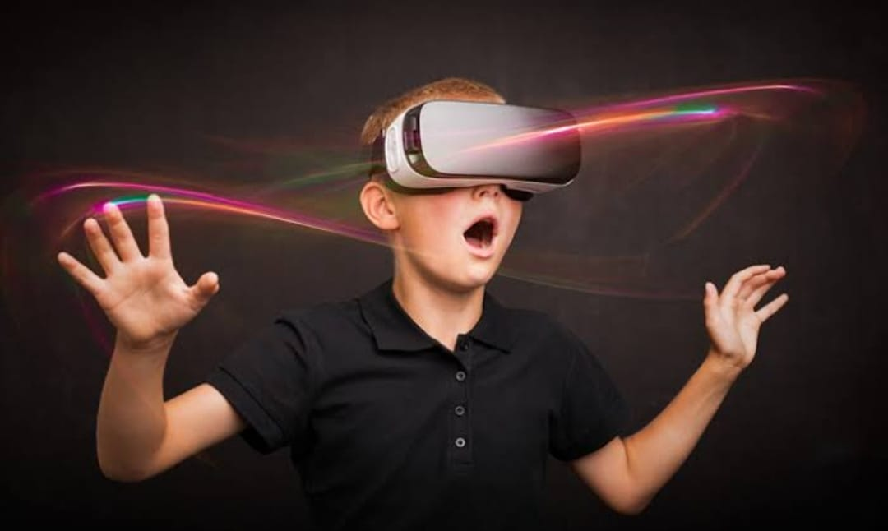
VIRTUAL REALITY:
Virtual Reality (VR) is a computer-generated
environment with scenes and objects that
Appear to be real, making the user feel they
are immersed in their surroundings.
This environment is perceived through a
device known as a Virtual Reality headset
or helmet.

Slide 4
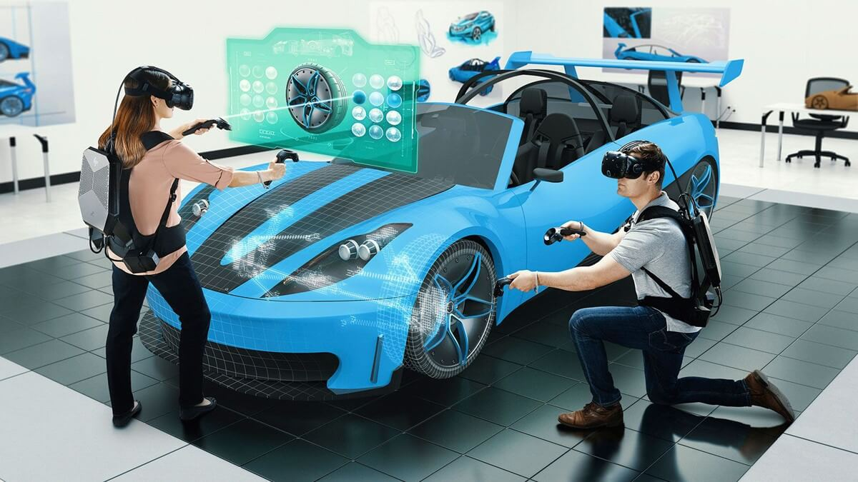
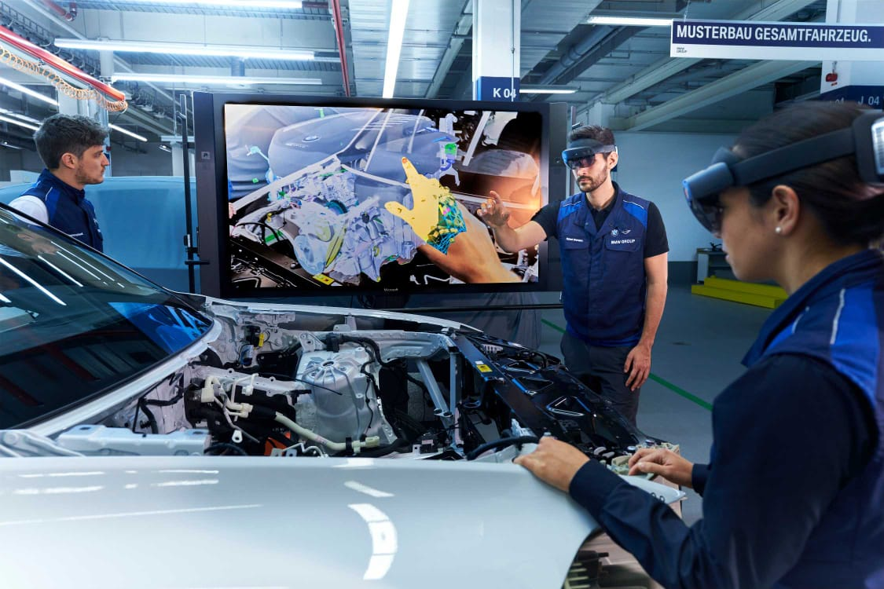
VR IN AUTOMOBILE INDUSTRIAL
VR in manufacturing industry enables the
designers to simulate their design prototype
or model on advanced VR software. This helps
them to rectify errors at the primary stage and
reduce production time and cost.
VR enables users to interact freely with
three-dimensional objects within virtual
environments through special hardware
like head-mounted displays (HMDs).

Slide 5
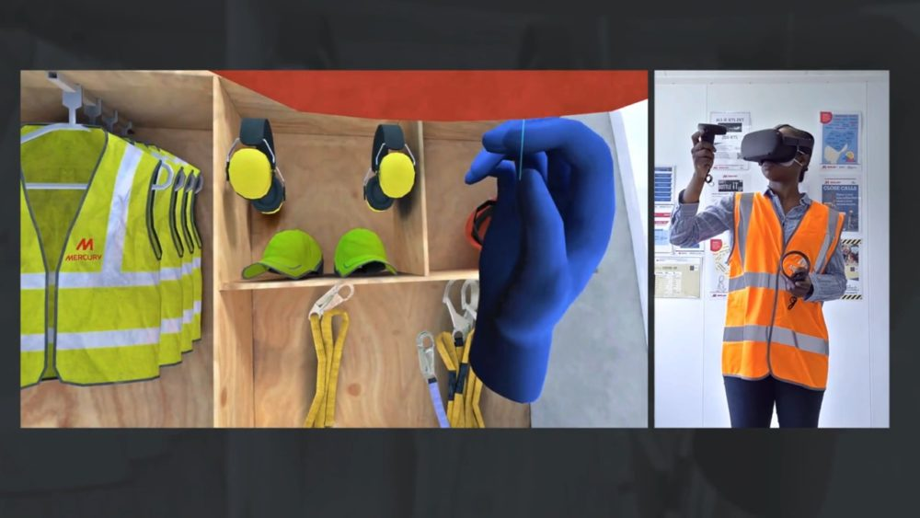
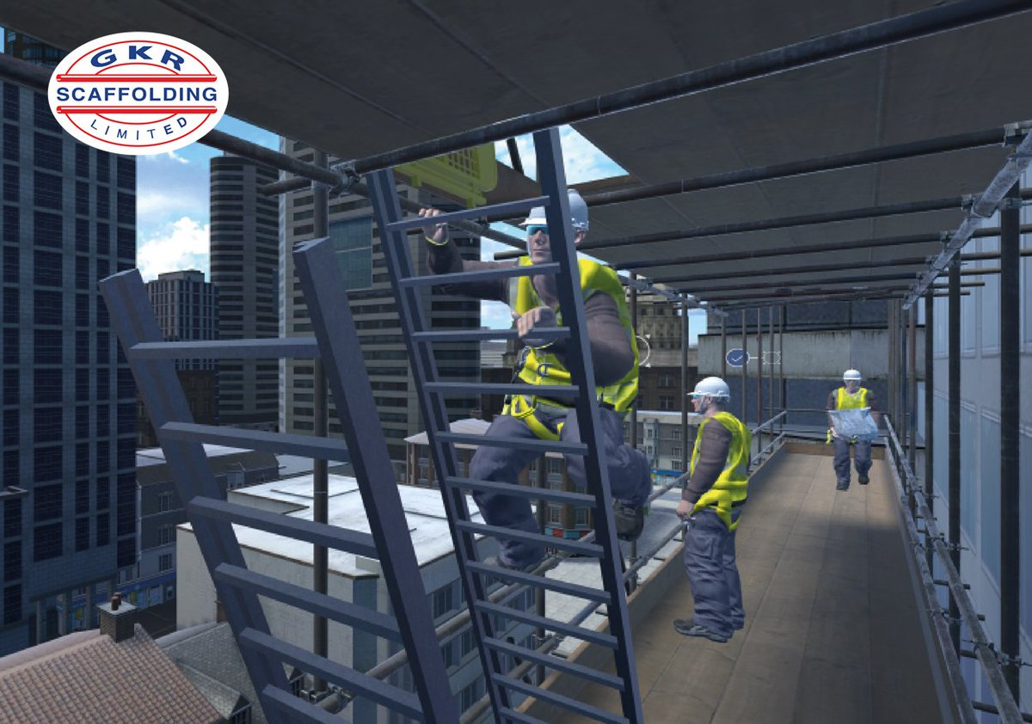
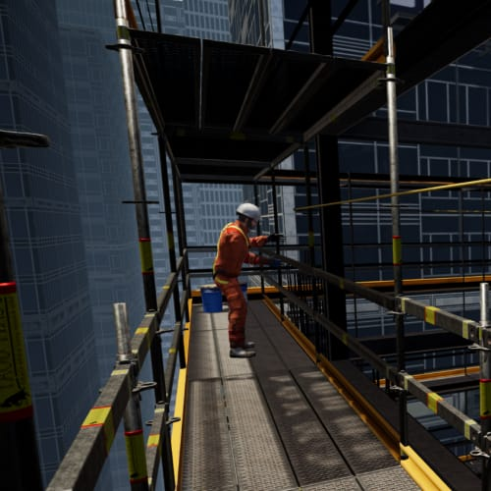
VR IN CONSTUCTION
Virtual Interactive Simulations & Guides
help operations, maintenance, and field
service teams perform complex procedures
faster, safer and with less errors. Our visual,
3D interactive and portable applications
allow them to practice procedures on
equipment virtually via web, PC, mobile,
AR and VR platforms.
Although the construction industry is one of the
largest sectors of employment in India, it is also
the second most hazardous, with an average of
around 38 fatal accidents a day.

Slide 6
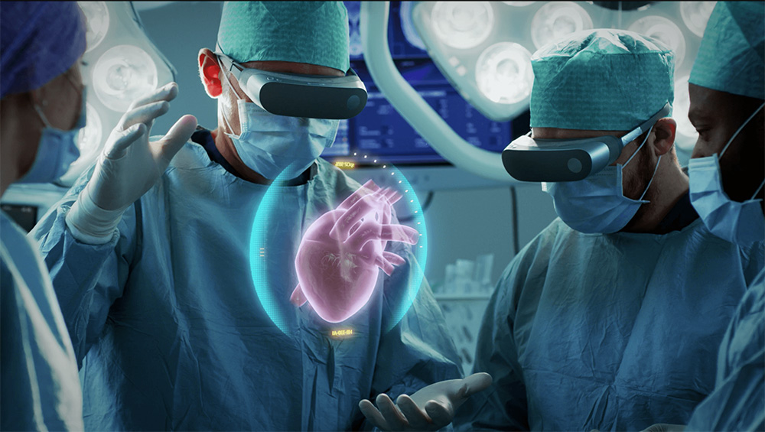
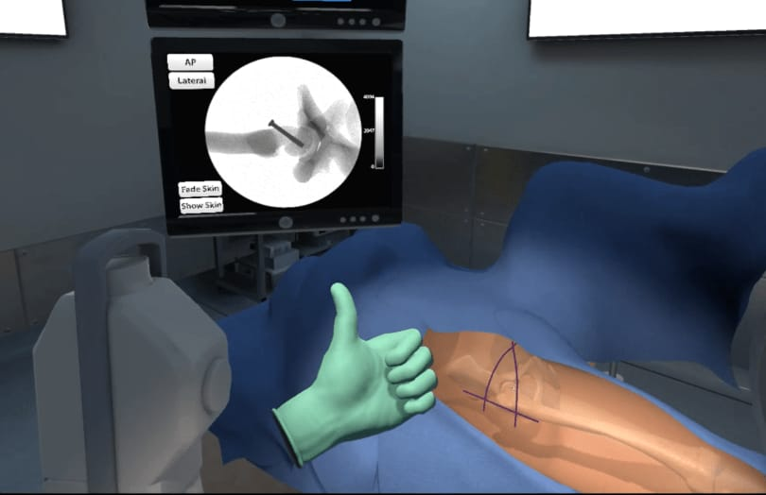
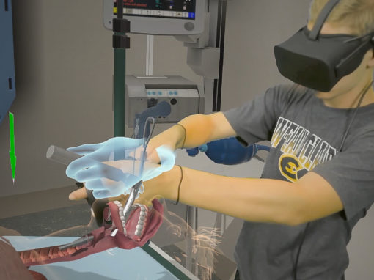
VR IN MEDICINE:
Virtual Interactive Simulations & Guides
help operations, maintenance, and field
service teams perform complex procedures
faster, safer and with less errors.
VR surgical simulation has been found very
useful in training medical professionals. This
helps them refine their skills and ultimately
reduces errors that could be fatal during
patients' treatment

Slide 7
CONCLUSION:
As we discussed from the about presentation we have get an idea about the VR usage and important role in the sites of technology in the industria field .
The main purpose of this technology to reduce the death rate and accidential fatal through the VR training methods to the employees .It helps to reduce expensive material costs by providing each individuals instead for this we are providing the VR programized heatset.

Slide 8
REFERENCE:
https://en.m.wikipedia.org/wiki/Virtual_reality
https://nap.nationalacademies.org/read/4761/chapter/18
https://developers.google.com/vr/develop/web/vrview-web

Slide 9


